Slide 1
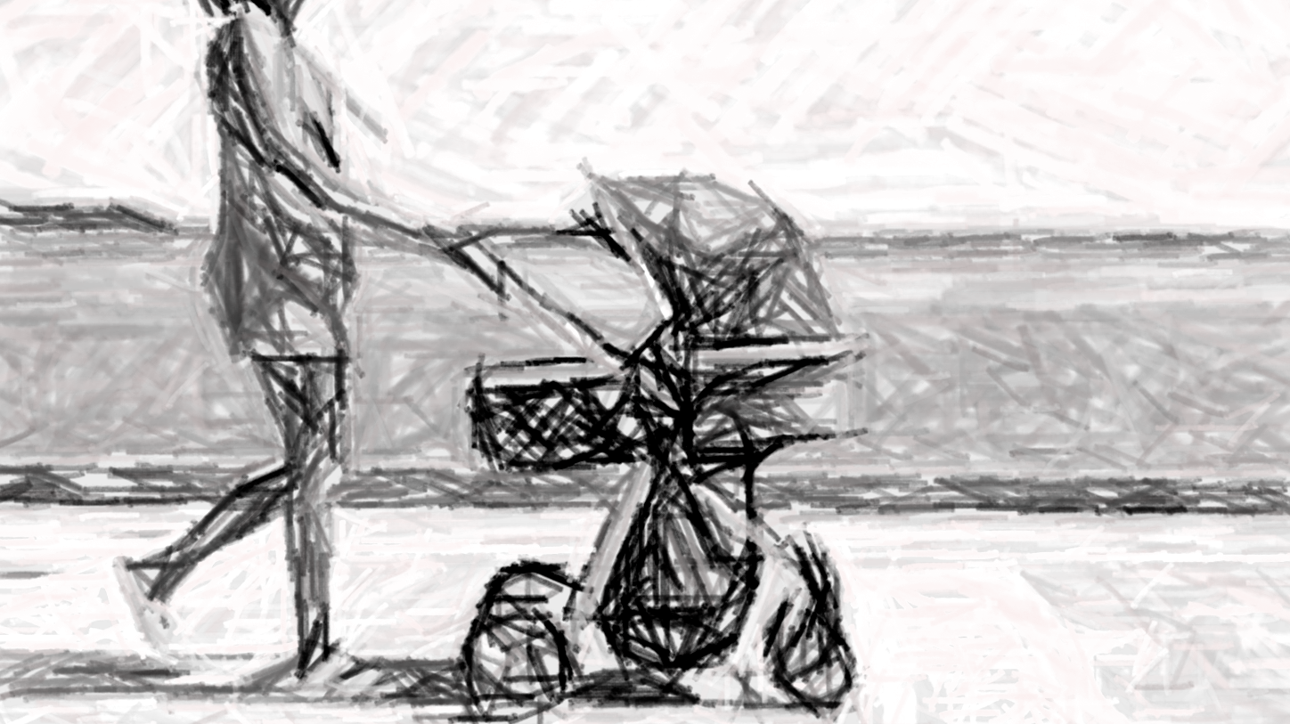
Automatic Braking System

Slide 2
Project Introduction
Who are we?
Our idea
Who is our product for?
Notes:
We are a group of 5 students from TIMEL3, (säg våra namn).
Our idea is to make a braking system for a baby-stroller, that automatically detects if the parent loses their grip of the handle, and the stroller keeps on moving or if the stroller starts moving on its own.
The product is made for stressed new parents.

Slide 3
Problem Statement
We aim to relieve stress for parents
  New parents already have enough on their plates
There is an existing stroller that aims to solve the same problem (that costs 2,290 CAD)
  Our approach is to make it cheaper and modular
Notes:
We want to relieve the stress for new parents, there is a lot going on when a small child recently enters someone’s day-to-day life. Therefore, we don’t want parents stressing over accidentally losing the grip of their stroller and something terrible happening.
There is already a stroller that has a similar approach, although it is very expensive. Our approach is to make it cheaper and modular so it can be used for most strollers that the parents already own.
Annat förslag:
Having a small kid brings a lot of new routines and tasks. Parents often have a lot on their minds—carrying bags, opening doors, talk to a sibling or maybe pick up something that was dropped.
It can happen to anyone: you lose your grip on the stroller for a second, maybe on a slope or near a street. It starts rolling away and something terrible can happen.
There is already a smart stroller on the market with an automatic brake, but it is very expensive. Our goal is to make it cheaper and modular, so that parents can add it to the stroller they already own.

Slide 4
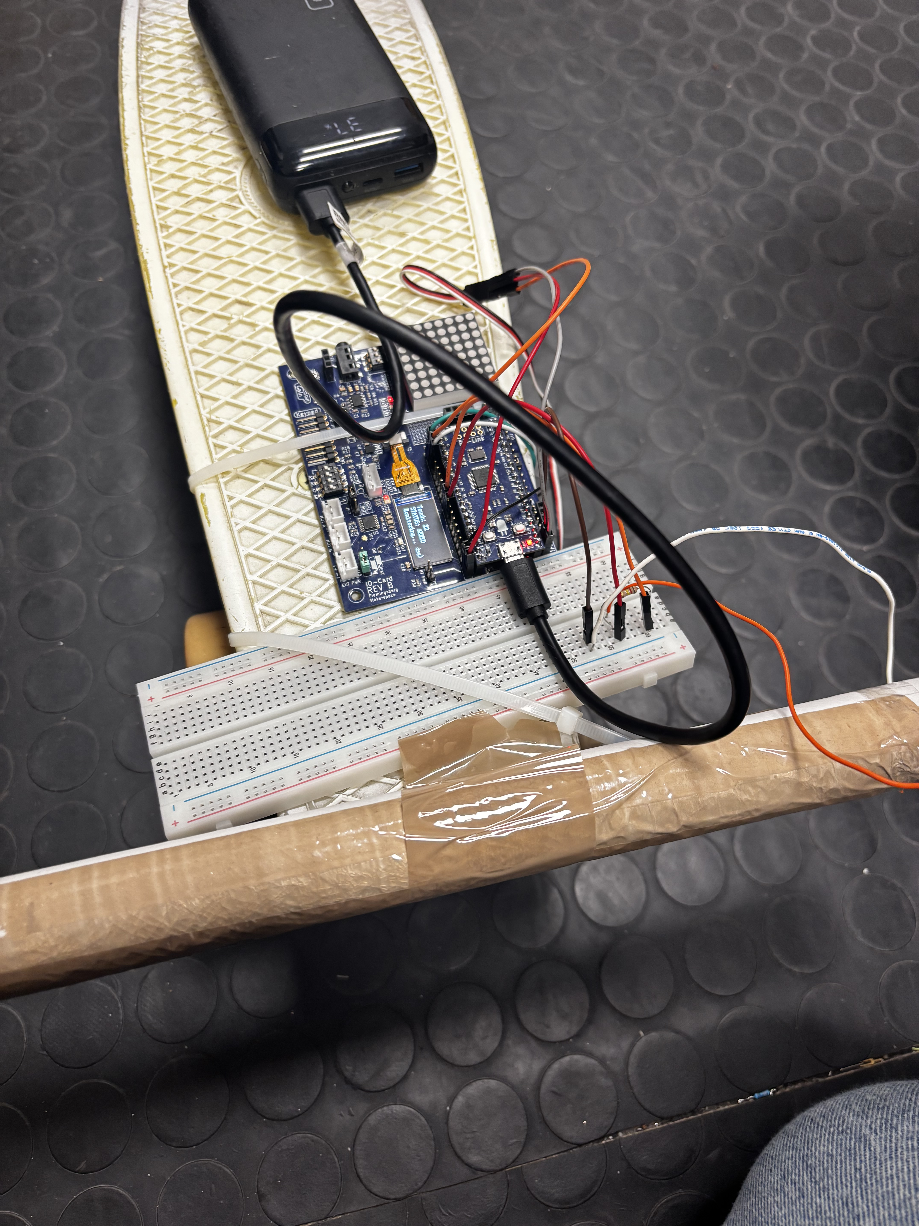
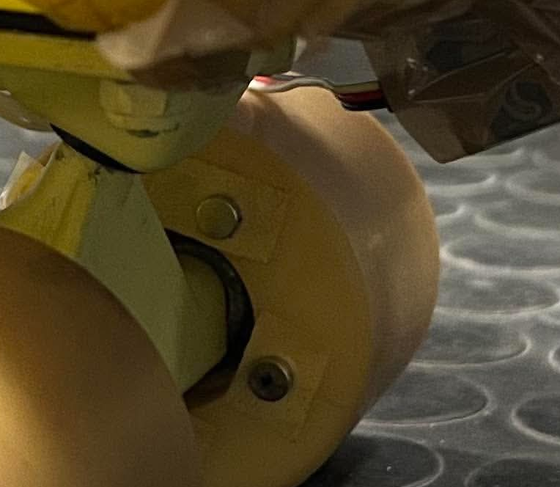
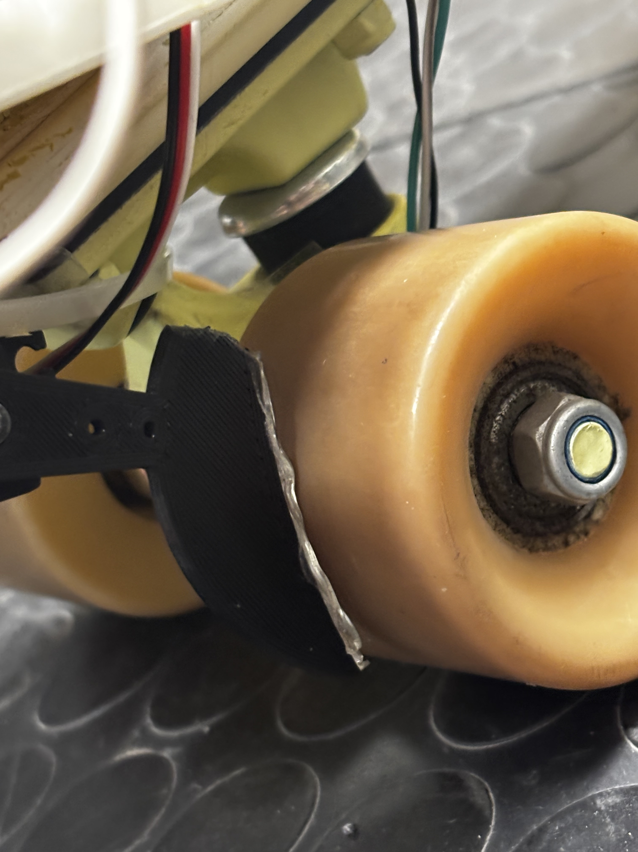
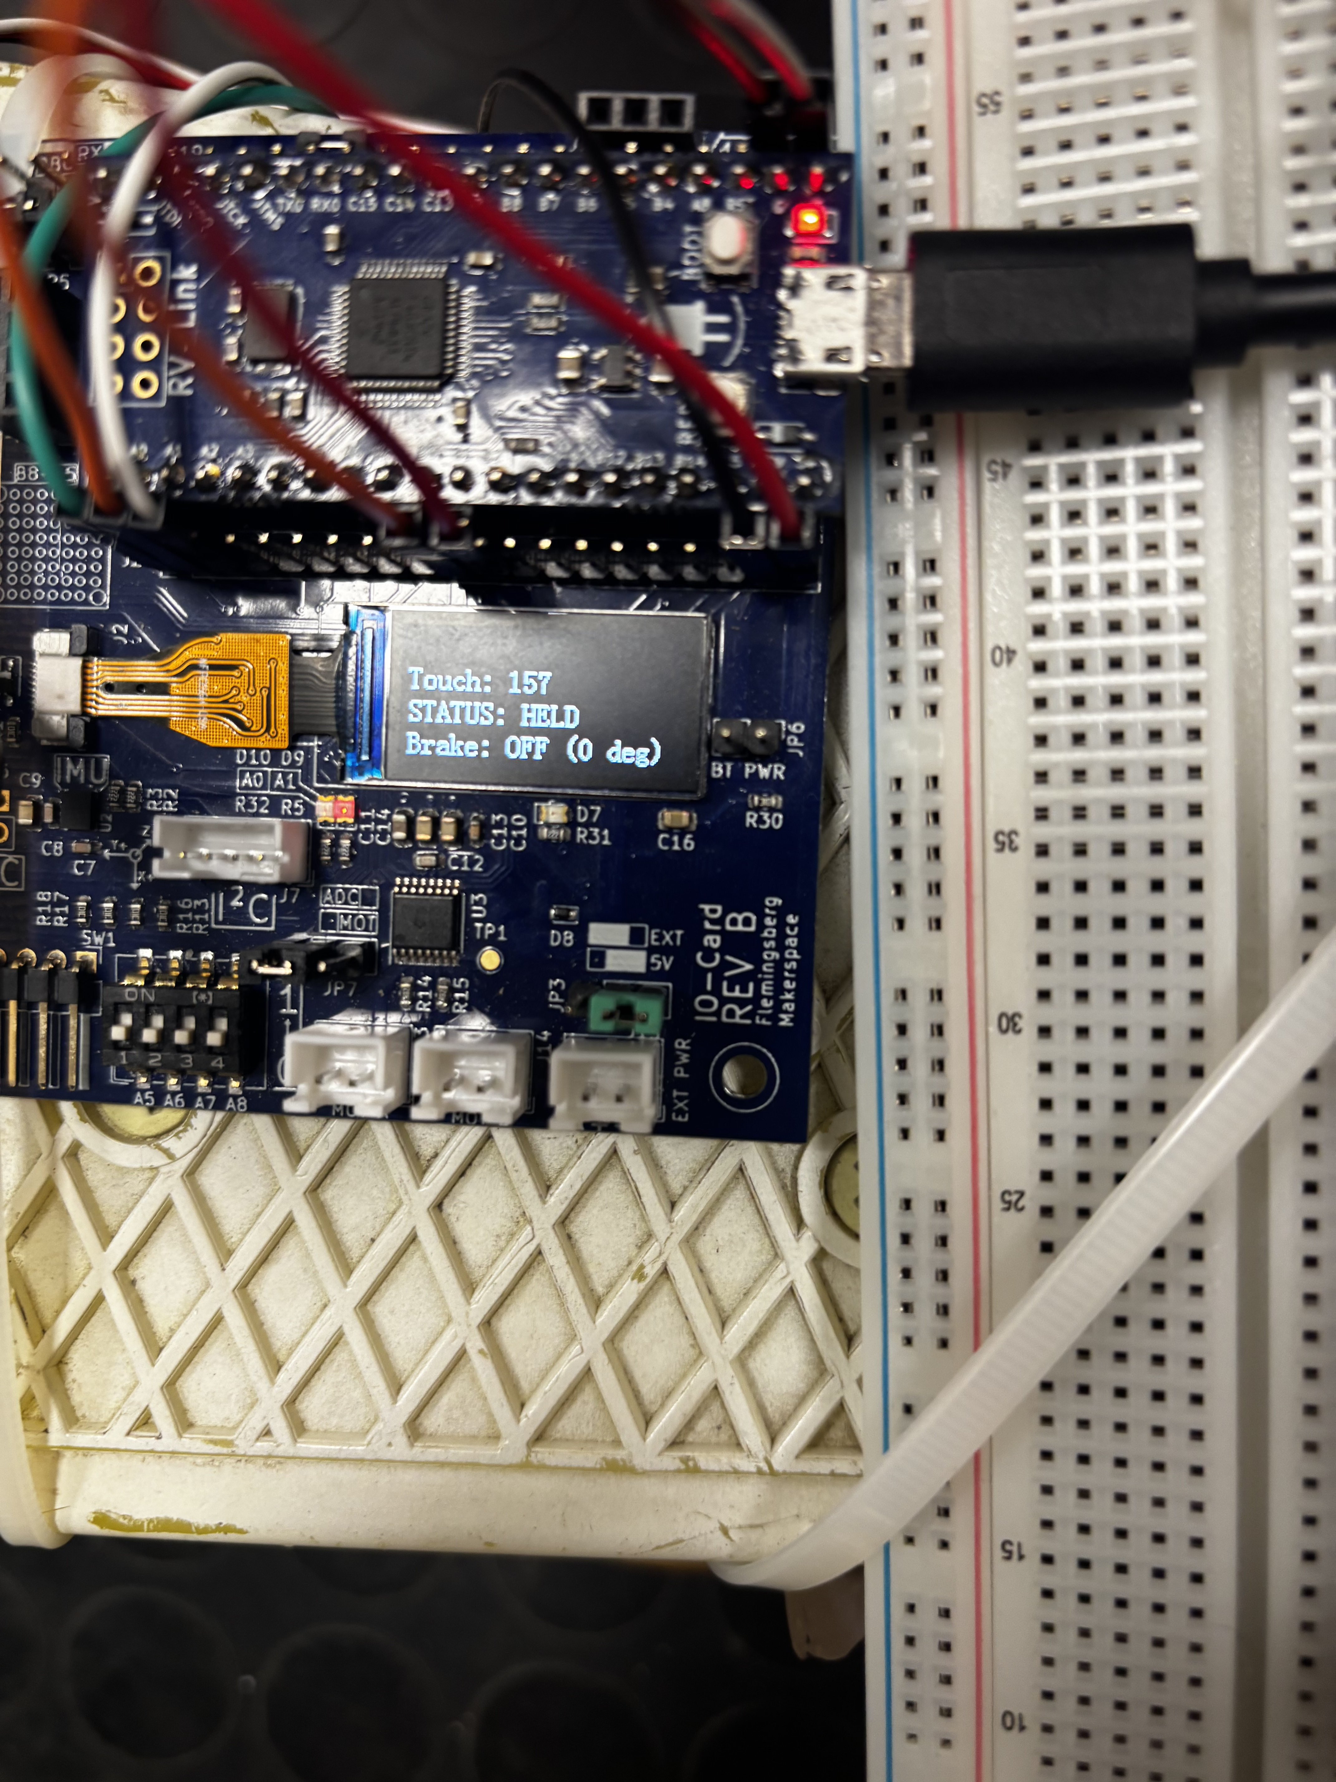
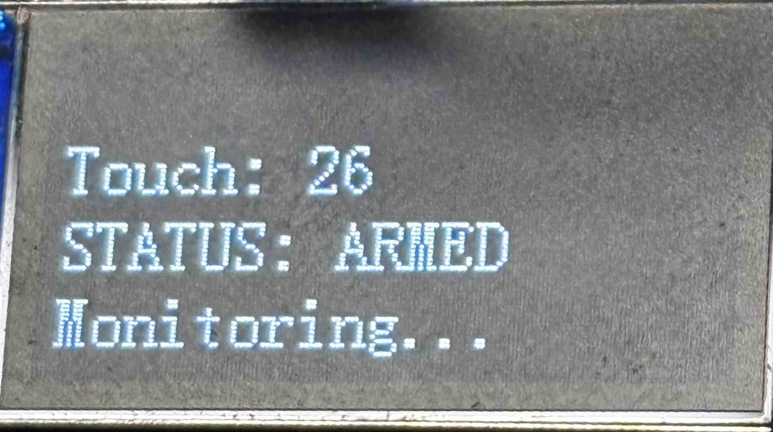
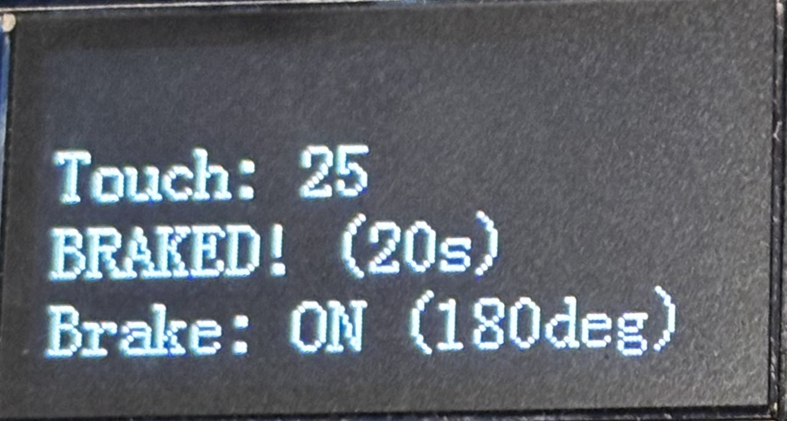
Technical Approach
Capacitive sensor in the handle
  Detects touch
IMU and Hall sensor
  Detects if the stroller is on the move
Servo-motor mechanism brakes if:
  1. The handle is not being held, and the Hall sensor detects movement
  2. The handle is not being held, and the IMU detects an incline/decline
  3. The handle is not being held, and the IMU detects shaking
RISC-V has four states (i.e., it is a state machine):
  1. Held : The handle is held, no need to check for movement (brakes turn off here)
  2. Waiting : The handle is not held, waits 3s, checks IMU for angle or shaking
  3. Armed : The handle is not held and the 3s has passed, checks IMU and Hall sensor
  4. Braked : Movement was detected by IMU or Hall sensor
Notes:
Förslag:
To make the stroller safe, we use a combination of sensors and a micro-controller.
First, we have a capacitive sensor in the handle. It detects if a parent is actually holding the stroller.
We also use an IMU and a Hall sensor near the wheels to detect if the stroller is moving, shaking, or on a slope.
If the system detects that the handle is not being held and the stroller starts moving, inclining, or shaking, a servo-motor mechanism immediately activates the brakes.
Everything is controlled by a RISC-V state machine with four states:
Held: The parent is holding the handle - the brakes are off.
Waiting: If you let go, there is a 3 seconds waiting time checking for tilt or shaking.
Armed: After 3 seconds, it actively monitors movement.
Braked: If any unwanted movement is detected (acceleration, tilt or shaking), the brake turns on instantly.
This keeps the stroller secure at all times.

Slide 5
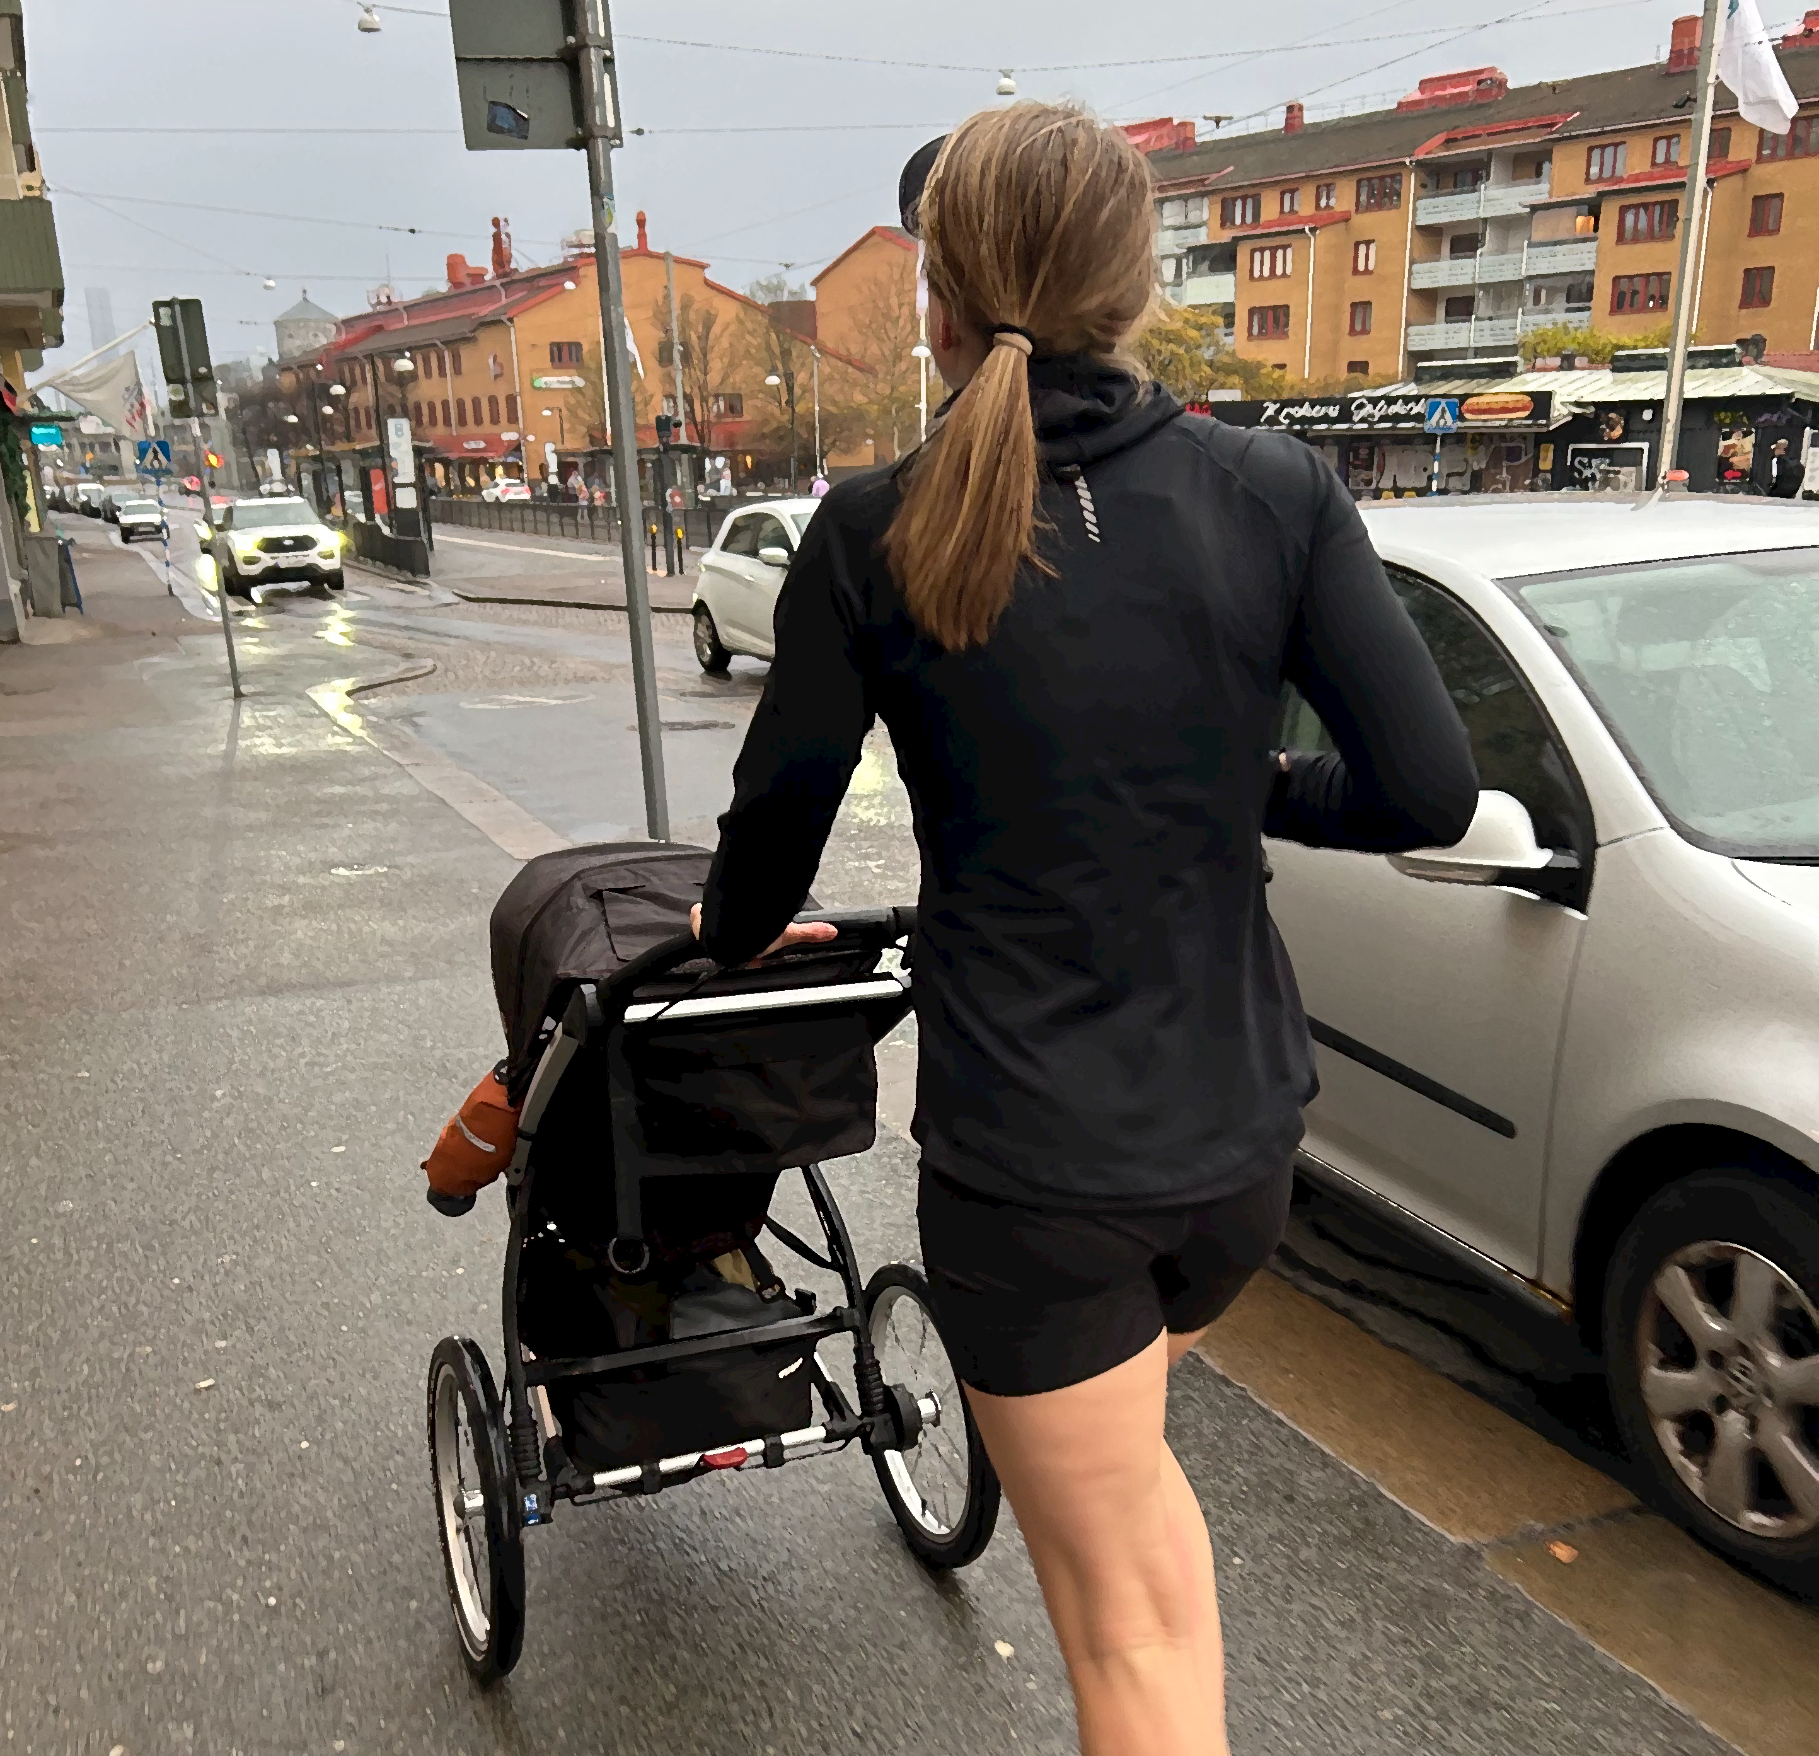
User Interaction
The ”user interface” is the handle
Intended to be installed on the stroller and then work on its own
User experience will hopefully be a de-stresser
Notes:
Förslag:
Most daily interactions happen naturally - when parents hold the handle, the stroller moves freely, giving them a stress-free experience.
When parents first buy the product, they simply install it onto their stroller. It should also be very easy to switch to a new stroller whenever they need to.
During daily use, the system automatically responds to the handle. We are currently fine-tuning the reaction delay after the handle is released to find the perfect balance between quick safety and smooth daily use.
Overall, our goal is a seamless interaction that keeps the baby safe and the parents stress-free.

Slide 6
Results (with a skateboard)
Waiting… (3s)
Notes:
Förslag:
As you can see, we built a working physical prototype to demonstrate/test (?) our solution.
We have successfully integrated all main components - the capacitive touch sensor in the handle, the Hall sensor, and the IMU. In our tests, all parts work together as expected, creating a functional smart-braking system.
From testing our prototype, we identified two main technical outcomes:
The brake mechanism works, but we need to increase the friction against the wheel to make the stopping force stronger.
As said before; we are fine-tuning the timer. Right now, the system waits 3 seconds after the handle is released. 3 seconds feels a bit too long in practice, but we are adjusting this to find the perfect balance.

Slide 7
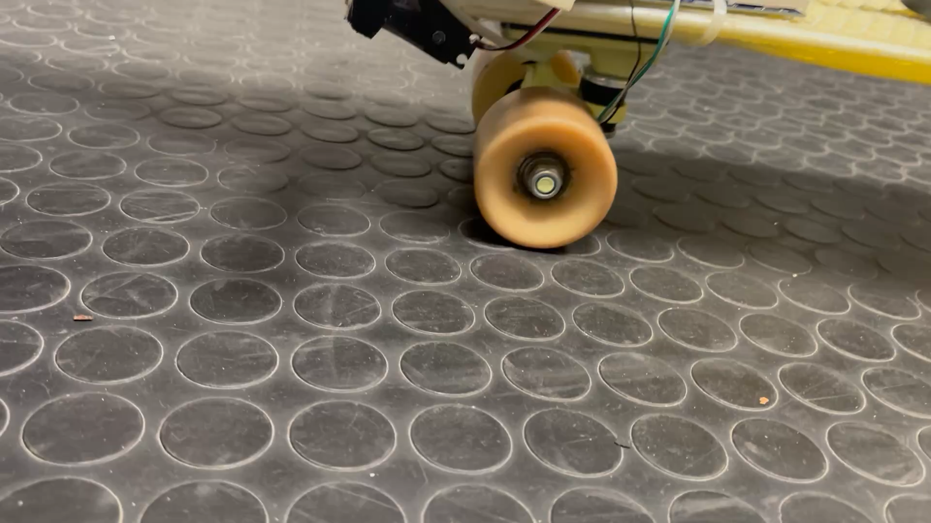

Slide 8


Project Methodology
Reflections:
  Wanted a challenge but also something practical
  Interesting to work in sprints & independently
  Weekly meetings were vital
  Difficult to find time together but we balanced the work
What we would do different:
  Get comfortable with GitHub quicker
  Assemble the prototype earlier for testing
  Try not to overcomplicate things
Notes:
Förslag:
When we started, we wanted a practical challenge where we could work independently and in sprints. Our weekly meetings were vital to keep us on track, especially since finding time together was difficult, but we balanced the workload well.
Looking back, there are a few things we would do differently next time:
We would get comfortable with GitHub quicker to improve our workflow.
We would also assemble the prototype earlier to get more time for real testing.
And finally, we should try to keep things simple and not overcomplicate things.

Slide 9
THANK YOU FOR LISTENING

